Slide 1

Business Intelligence Guidebook – From Data Integration to Analytics
www.biguidebook.com
November 2014
Imprint: Morgan Kaufmann
Print Book ISBN : 9780124114616
eBook ISBN : 9780124115286

Slide 2
Chapter 10 Business Intelligence
Dimensional Modeling
Information in this chapter:
Hierarchies (balanced, ragged, unbalanced and variable-depth)
Outrigger tables
Slowly changing dimensions
Causal dimensions
Multivalued dimensions
Junk dimensions
Value band reporting
Heterogeneous products
Hot swappable and custom dimension groups

Slide 3
Outline
Hierarchies
Balanced Hierarchies
Ragged Hierarchies
Unbalanced Hierarchies
Working with Variable-Depth Hierarchies
Outrigger Tables
Slowly Changing Dimensions
SCD Type 0: Keep Original
SCD Type 1: Overwrite Existing Data
SCD Type 2: Create New Row
SCD Type 3: Track Changes Using Separate Columns but Overwrite the Rest
SCD Type 4: Add Mini-Dimension
SCD Type 5: Combine Types 4 + 1
SCD Type 6: Combine Types 1 + 2 + 3 (=6)
SCD Type 7: Use both Types 1 + 2
Causal Dimension
Multivalued Dimensions
Pick One Value, Ignore Others
Extend the Attributes
Bridge Table
Junk Dimensions
Misguided Attempts
Recommended Solution
Value Band Reporting
Heterogeneous Products
Alternate Dimensions
Hot Swappable Dimension
Custom Dimension Groups
Too Few or Too Many Dimensions

Slide 4
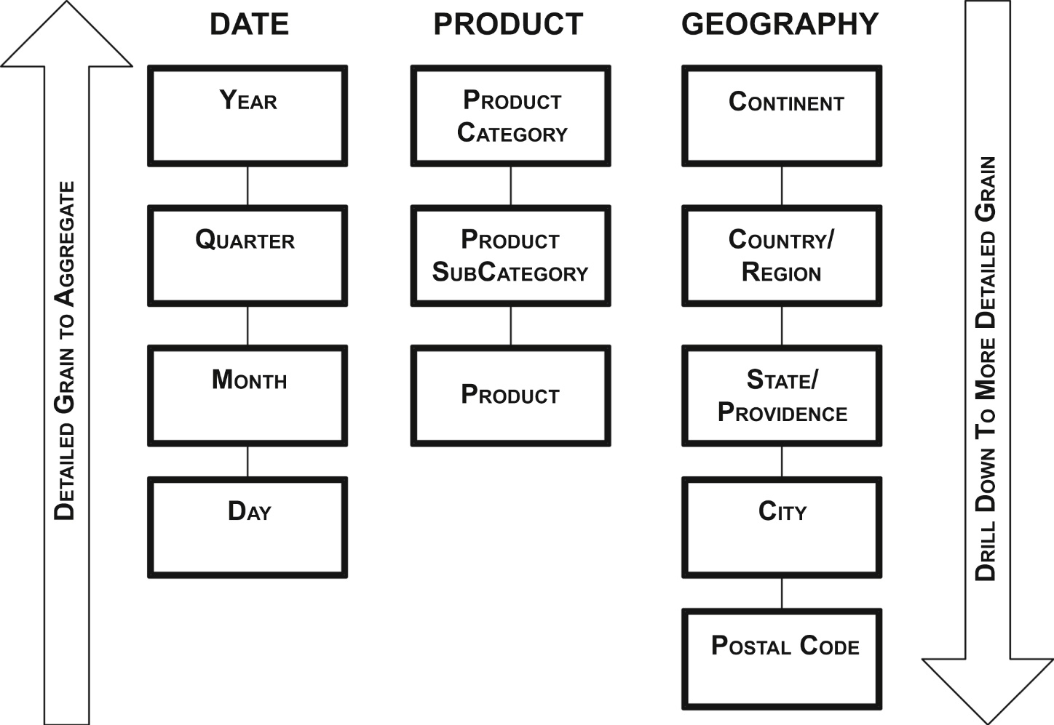
Hierarchies
f10-01
Many dimensions are hierarchical. Figure 10.1 shows some examples:
Calendar date, which goes from year to a quarter, to month, and ending with day.
Product, which goes from product category, breaking out into product subcategory, and ending with product.
Geography, which goes from continent, to country, state, city, and ending with postal code.

Slide 5
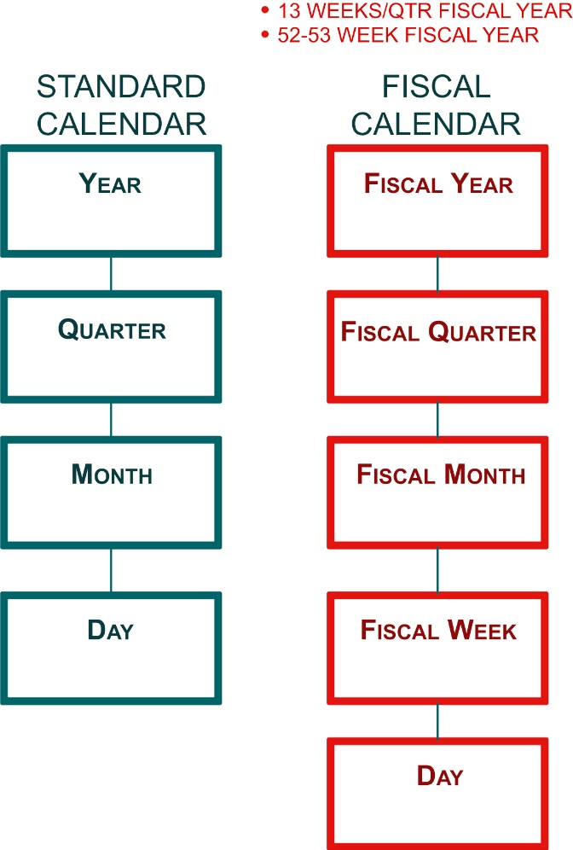
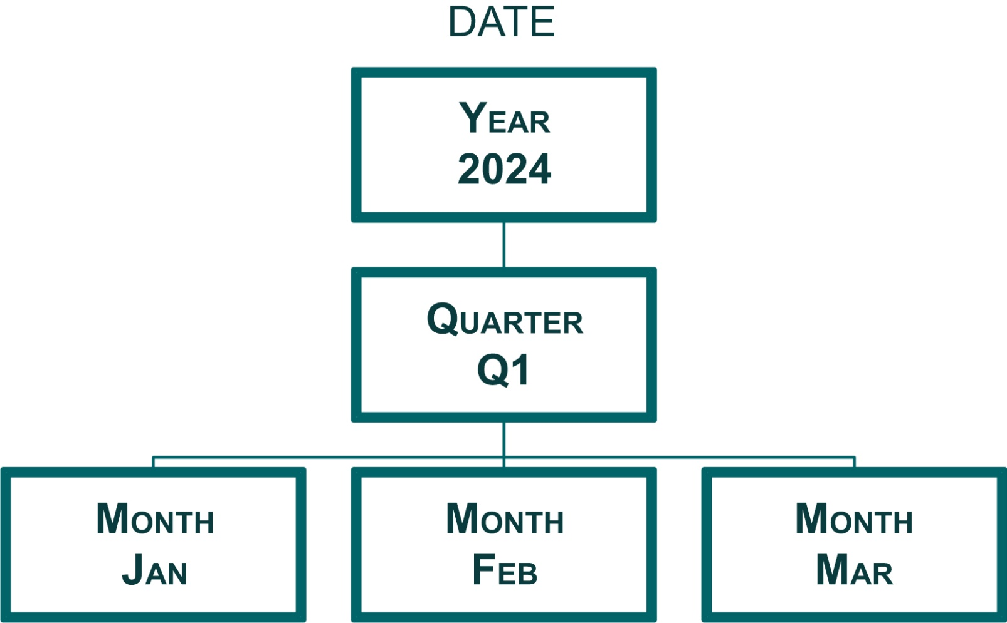
Types of Hierarchies: (1) Balanced Hierarchies
In a balanced hierarchy: all dimensional branches have the same number of levels
f10-02
f10-03
Figure 10.2 illustrates a balanced hierarchy. In this example, a year breaks down to a quarter, breaking down to months. An actual date would be the highest level of detail and lowest level in the hierarchy. The date dimension in Figure 10.3 illustrates a dimension with multiple hierarchies. In this example, an enterprise has a fiscal calendar that begins on July 1 and has a 4-4-5-quarter (4 weeks for fiscal months 1 and 2, and 5 weeks assigned to fiscal month 3.)

Slide 6
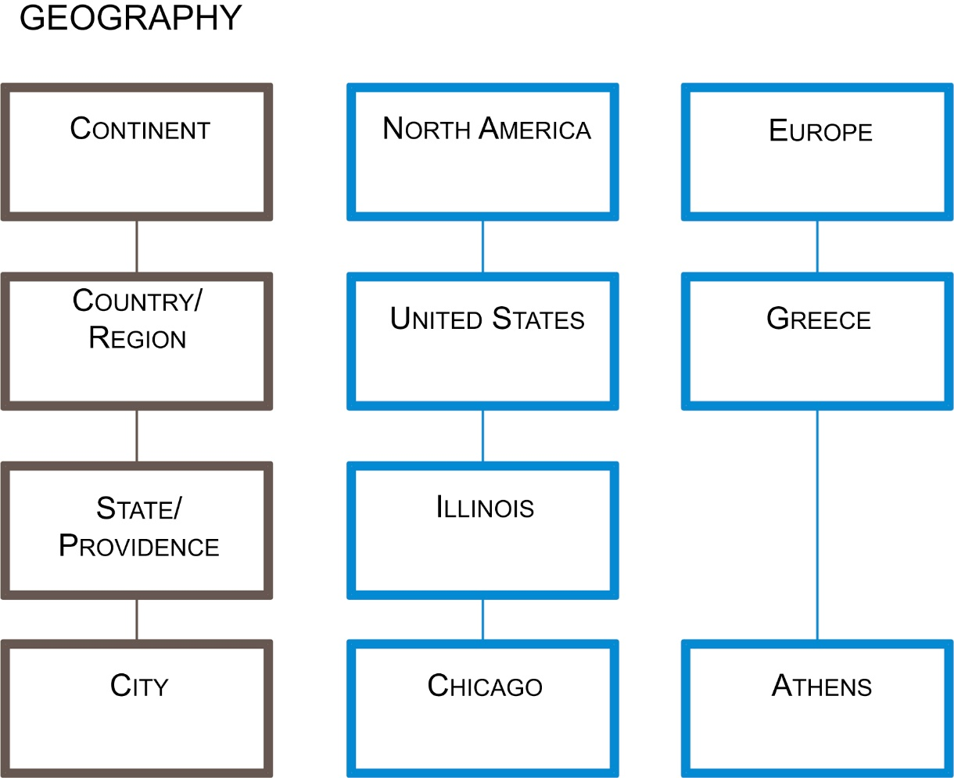
Types of Hierarchies: (2) Ragged Hierarchies
A ragged hierarchy has the parent member of at least one member in the hierarchy that is not in the level immediately above it. In short, levels are skipped in the hierarchy.
f10-04
A typical example, as shown in Figure 10.4, is a geography or sales territory dimension. In the example, one branch has the continent of North America, country of United States, state of Illinois, and city of Chicago. The other branch has Europe as the continent, Greece as the country, and Athens as the city, but there is no state that is applicable to this dimension. In this example, each branch has a different depth and one branch has a gap, making this a ragged hierarchy.

Slide 7
Handling Ragged Hierarchies
If there is a limited number of levels and gaps in a hierarchy, then the pragmatic approach to handling aggregating data is to treat it as a balanced hierarchy (i.e. handle the missing values):
Depending on how the business wishes to handle the missing values, there are two options for what to populate in the missing attributes, just be sure to not use NULL in either case:
• An agreed-upon default value. In this example, that could be “not applicable” or “no state.” • The value of the level above the gap. In this example, “Greece” would be used as the State attribute.
If the hierarchy has many levels and gaps then use the approach discussed in handling variable depth hierarchies.

Slide 8
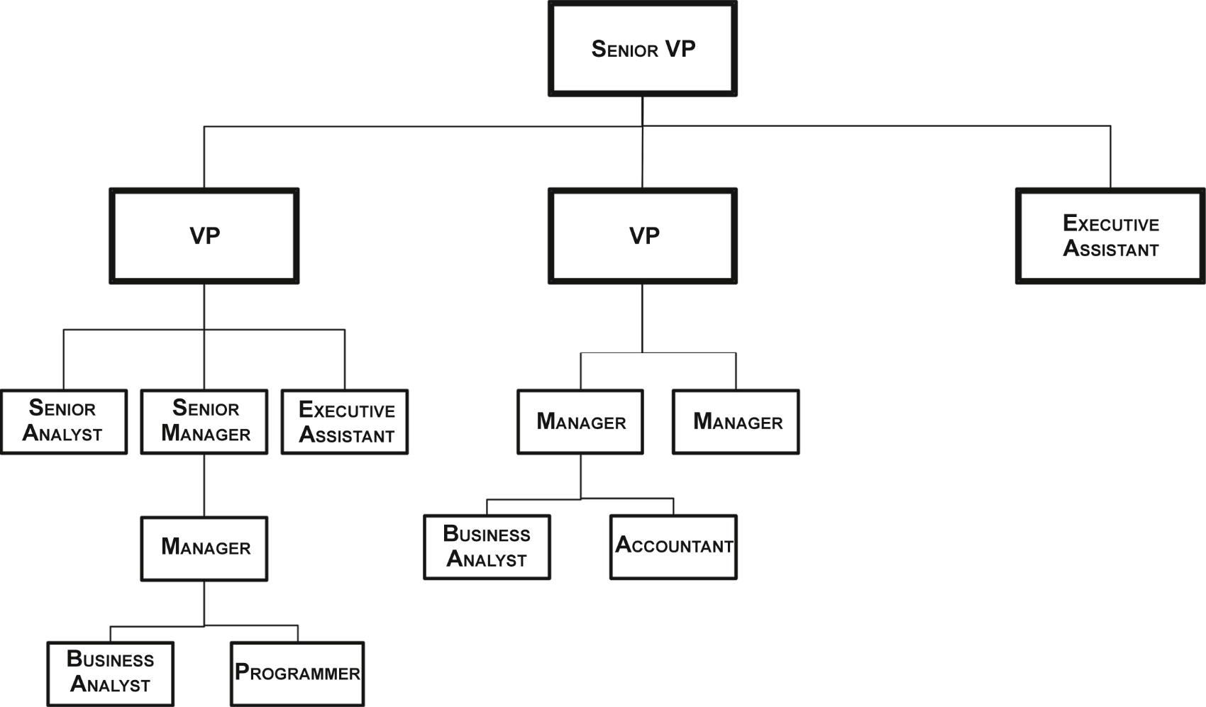
Types of Hierarchies: (3) Unbalanced hierarchies
Unbalanced hierarchies occur when the dimensional branches have varying numbers of levels—inconsistent depths while still having a consistent parent-child relationship.
f10-05
The classic example, as shown in Figure 10.5, is an organizational chart. In the example, as we traverse through a senior vice president’s organization, the reporting relationships among employees vary widely. The organizational structure is unbalanced, with some branches in the hierarchy having more levels than others, the number of employees at each level varies, and employee titles are not uniform across a level. But there is always a parent–child relationship until the branch encounters a leaf node, such as an employee without anyone reporting to him or her. Obviously, an enterprise organizational chart would be much bigger than this, but it would still show a large amount of variation in the levels of the organization.

Slide 9
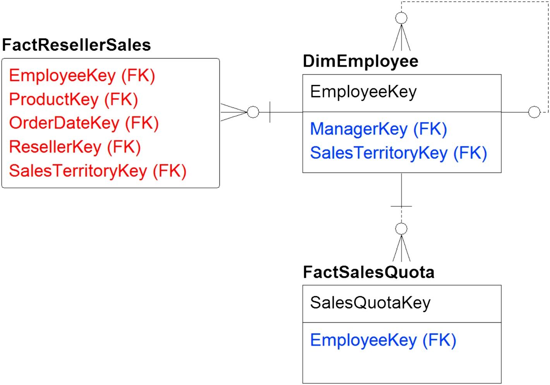
Employee recursive example
Working with Variable-Depth Hierarchies: (1) Recursive Pointer
The term variable-depth hierarchy refers to both unbalanced and ragged hierarchies.
For accurate results, you need to understand and implement your approach to handling these various levels and not simply leave it up to the BI tool to aggregate and drill down by using the hierarchy levels.
f10-06
Figure 10.6 also illustrates how the fact tables, FactRellerSales and FactSalesQuota, are linked to the employee dimension table DimEmployee by using the foreign key EmployeeKey. The intent of the relationship is to determine which employee was responsible for a sale along with his or her sales quota, and then use the recursive relationship to aggregate the measures up to the top person in the organizational chart. You would only be able to perform the aggregation with custom coding and not with BI tools or standard SQL.

Slide 10
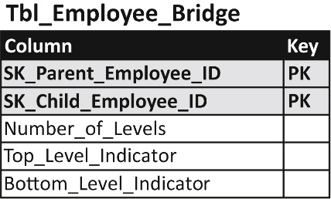
Bridge table example
Working with Variable-Depth Hierarchies: (2) Bridge Table
f10-07
The second approach to handling variable depth hierarchies, which happens to be the best practice, is to create a bridge table that enables the relationships between the dimension and facts. A bridge table template design is depicted in Figure 10.7. The bridge table’s columns are:
SK_Parent_Employee_ID—This is the parent identifier. It is paired with SK_Child_Employee_ID as a combination primary key.
SK_Child_Employee_ID—This is the child identifier. It is paired with SK_Parent_Employee_ID as a combination primary key.
Number_of_Levels—This is the number of levels from the parent (top level)
Top_Level_Indicator—This is a flag indicating if this is the top level.
Bottom_Level_Indicator—This is a flag indicating if this is the bottom level.
The issue with this approach is that it adds complexity to the model; it’s generally too complex for business people to manipulate directly. But the reality is that complexity is added because it’s needed.

Slide 11
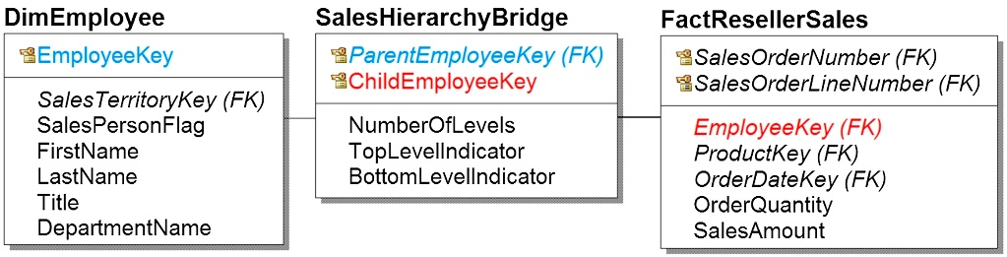
Bridge table navigation – Traversing Down: top (summary) to detail, or Traversing Up – detail to top (summary)
f10-08
Traversing down using the example in Figure 10.8, would look like this:
Start with FactResellerSales.
Record SalesEmployeeKey, which is the salesperson’s employee identification.
Next is the dimension DimEmployee, which lists all the employees in the company, their first name, last name, title, department number, and all their attributes as well as the sales territory key and the salesperson flag indicating they are salespeople.
In the middle is the sales hierarchy bridge, which gives the parent employee key SK_Parent_Employee_ID, and the child employee key, SK_Child_Employee_ID, along with the total number of levels. There is a top level indicator, typically yes or no, and a bottom level indicator, also typically yes or no.
When you’re going down in aggregation, the fact joins the parent key level (remember, the data has already been aggregated). Then the dimension joins the child key row; then you move down into the lower level of detail.

Slide 12
Bridge table navigation – Traversing Down: top (summary) to detail, or Traversing Up – detail to top (summary) - (Cont…)
f10-08
Traversing up in the detailed data using the same example would look like this:
• The level of grain is the sale transaction, which includes the employee who made the sale. • FactResellerSales joins the hierarchy of the child key row with foreign key SK_Child_Employee_ID. • Then the dimension Dim_Employee joins the parent key SK_Parent_Employee_ID of the sales hierarchy bridge. • That gets us the salesperson’s manager. • So, the salesperson is the child, the manager is the parent. Then you can do a tree walk up the employee levels.

Slide 13
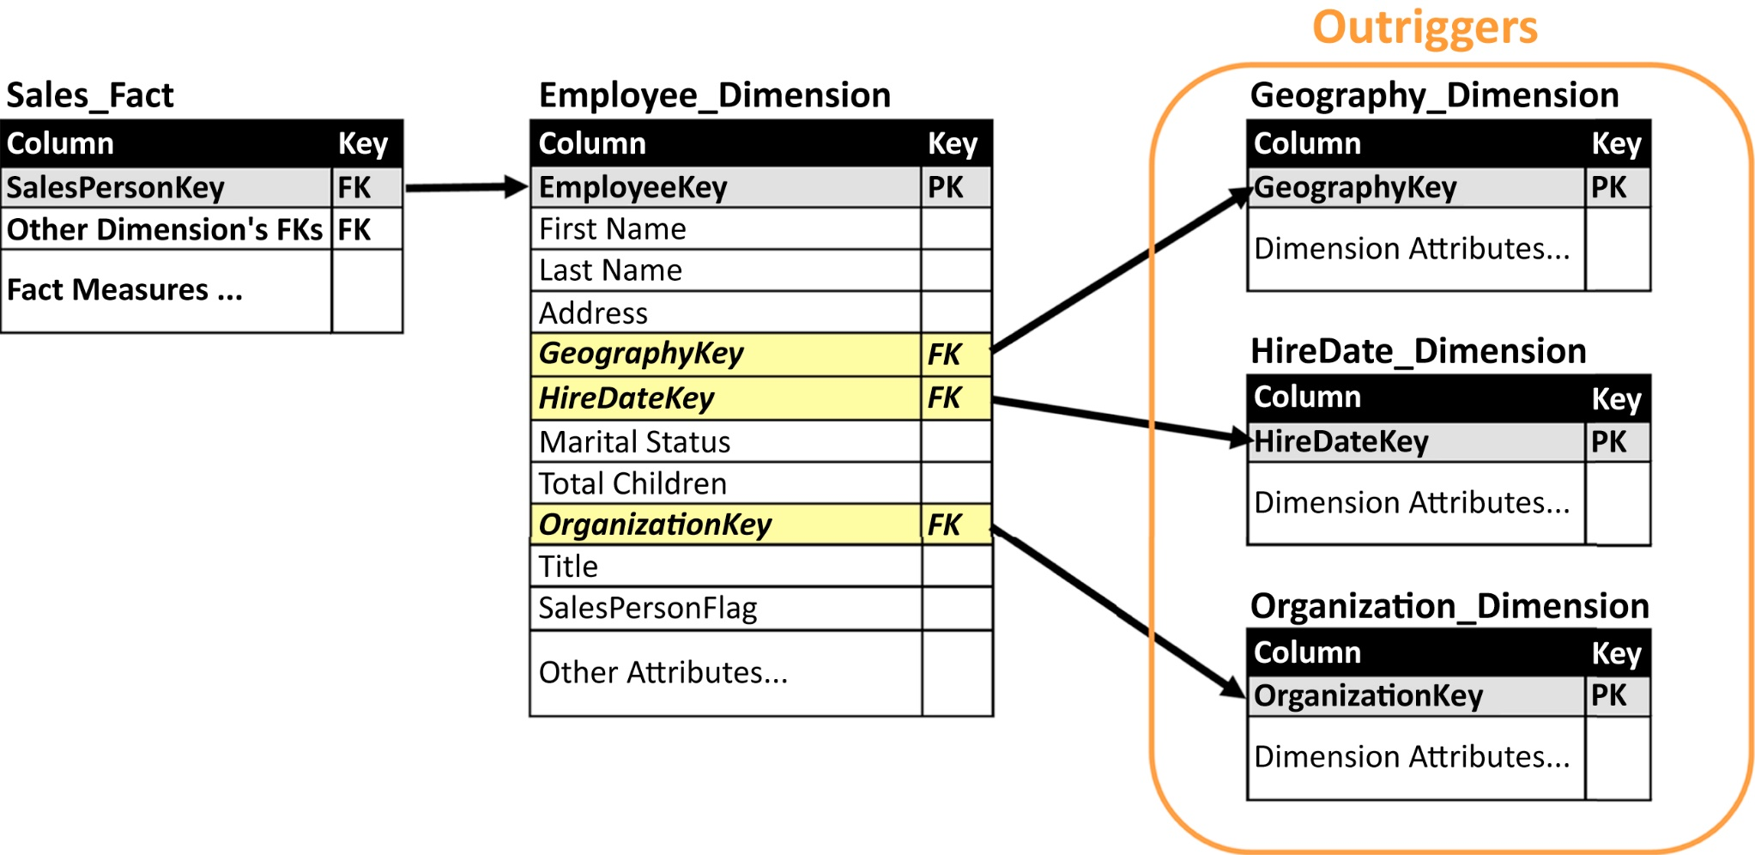
Dimension outriggers
The classic star schema has facts linked to dimensions without any relationship between dimensions themselves.
Modeling an enterprise, however, is never that clear-cut and there are several conditions when dimensions link to other dimensions.
We have discussed two of these conditions: snowflakes and bridges; the third condition is outriggers.
Outriggers are used when a dimension is referenced within another dimension.
f10-09
Figure 10.9 depicts an employee dimension that is linked to three outriggers: geography, hire date, and organization dimensions. In the initial design of the employee dimension, some of the outriggers’ attributes may have been part of that dimension until more detailed review uncovered that these attributes should remain in their respective dimensions to be referenced by the employee dimension.
Using outriggers eliminates the need to redundantly store and update dimensional attributes in multiple locations. An example of this would have occurred if the attributes, such as a department’s name, manager, and size, were placed in the employee dimension rather accessing them in the organization dimension via a foreign key.

Slide 14
Slowly Changing Dimensions
Dimensions have attributes that change over time. Products change price, cost, and composition. Employees are promoted, fired, change departments, and get new titles. Customers change addresses and names, get married or divorced, and move into different income brackets. These changes occur infrequently and unpredictably.
A business’s operational and transaction processing applications keep dimensional tables updated to the most current values to support ongoing business processes. Operational applications do not track changes to dimensional values because transactions only need the most current values. In addition, operational reporting uses data from the point in time that the transaction occurred, which is referred to as either “as was” or “as transacted.”
As you shift from operational to management analysis, however, the business needs to examine the facts (transactions and business events), not only in the context of the dimensional values at that point in time (“as was”), but also in the context of what the fact would look like if it occurred now with the current values of dimensions (“as is”) . The capability to use either the “as was” or “as is” context is critical in business analysis such as examining trends, comparing period-versus-period performance and creating predictive models.

Slide 15
Slowly Changing Dimensions
Based on the need for a business to analyze both “as was” and “as is” states, several techniques referred to as types were created in dimensional modeling to record these changes and manage SCD:
SCD Type 0: Keep Original (writes the original dimension record but then never updates it).
SCD Type 1: Overwrite Existing Data
SCD Type 2: Create New Row
SCD Type 3: Track Changes Using Separate Columns but Overwrite the Rest
SCD Type 4: Add Mini-Dimension
SCD Type 5: Combine Types 4 + 1
SCD Type 6: Combine Types 1 + 2 + 3 (=6)
SCD Type 7: Use both Types 1 + 2

Slide 16
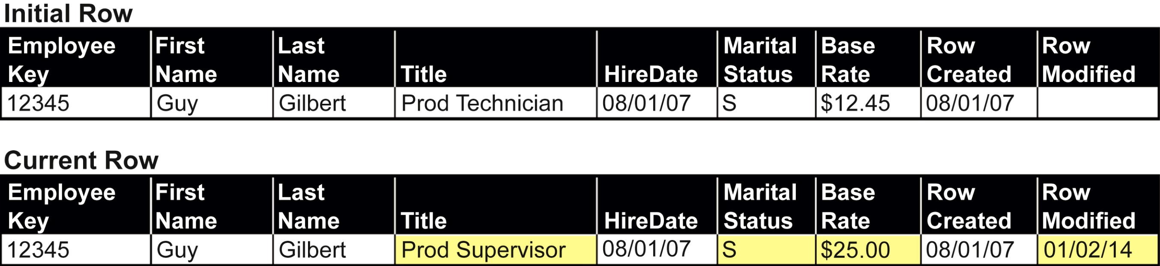
SCD type 1: Overwrite existing data
f10-10 Employee dimension- Overwrite existing data
The type 1 technique is to overwrite historical values of dimensional attributes with the most current values.

Slide 17
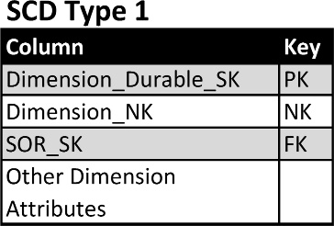
Type 1 schema template
Figure 10.11 depicts a template schema supporting the SCD type 1 technique. The template columns show:
• Dimension_Durable_SK: This is the surrogate key used as the primary key for this dimension. This column is referred to as the durable, supernatural, or durable supernatural key. The term durable is used because the key values that are assigned to a dimension will continue to be used regardless of any changes in the values in the systems of record (SOR) (i.e., this key doesn’t change for different versions of the same entity). The term supernatural is used to distinguish the key as independent from the SOR natural key.
• Dimension_NK: This is the natural key from the SOR. This column has the data type of the SOR if there is only one SOR or if all the SORs have the same data type. If there are multiple source systems with different data types, then use a data type such as a character string that can store all the natural keys’ values.
• SOR_SK: If the dimension has multiple SORs, such as a product dimension obtaining product lists from multiple source systems, then the SOR_SK is the foreign key linking to the SOR dimension depicted in Figure 10.11.
• Dimension attributes: There are one or more columns providing the values of all the attributes that the business needs to track.
f10-11 Type 1 schema template
A durable key remains the same for all historic records of an entity.

Slide 18
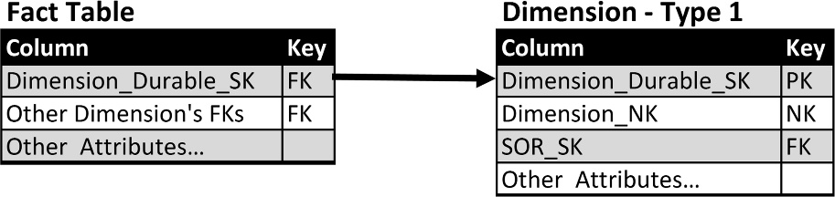
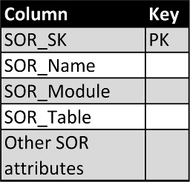
In the type 1 technique, fact tables linked to a dimension table use the foreign key. For example, see Dimension_Durable_SK in Figure 10.12.
f10-12 Fact table links to SCD type 1 dimension
Figure 10.13 depicts a template for a system of record dimension that lists information regarding the source systems used to populate dimensions. The template columns show:
SOR_SK: The surrogate key identifying the source system.
SOR_Name: A name identifying the source system, typically an application name.
SOR_Module and SOR_Table: If there is a need to identify SOR granularity greater than SOR_Name, then add these two columns to the dimension. For example, the SOR_Name identifies an application, the SOR_Module identifies a module within the application, and the SOR_Table lists the table the data is obtained from.
SOR_Attributes: There are one or more columns providing the values of all the attributes that the enterprise needs to track.
f10-13 SOR dimension

Slide 19
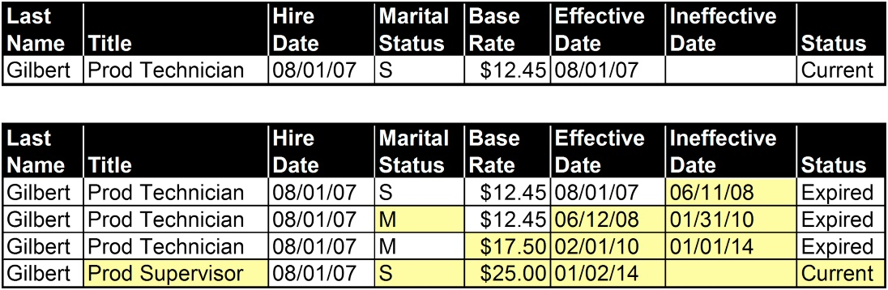
SCD type 2 : Create new row
f10-14 Create new row
The type 2 technique creates a new row in the dimension table every time a change occurs in an attribute that we wish to track. Unlike type 1, it enables you to track history accurately, so you see every time an attribute changes in that row and for that employee, as shown in Figure 10.14. It enables both “as is” and “as was” analysis.
This technique keeps track of all the historical changes in the dimension, allowing you to use the values of the dimension attributes at any point in time and examine the impact of those changes on the relevant fact tables. For example, if you’re looking at sales of specific products, you can look at what their retail price or production cost was at the point of sale and examine the impact of price or cost changes that occurred since.

Slide 20
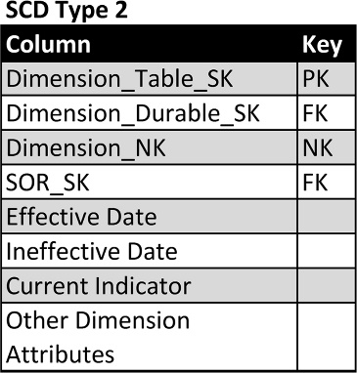
SCD type 2 template
• Dimension_Table_SK: This is the surrogate key used as the primary key for this dimension. Create a new row every time any of the dimensions have attributes that change. This key cannot be used to identify a specific dimension, such as a particular product or customer.
• Dimension_Durable_SK: This is the durable key for the dimension, such as a product or customer that uniquely identifies that dimension but does not provide uniqueness in this type 2 table if there have been changes to the dimension’s attribute.
• Dimension_NK: As with SCD type 1, this is the natural key from the SOR. This column has the data type of the SOR if there is only one SOR or if all the SORs have the same data type. If there are multiple source systems with different data types, then use a data type such as a character string that can store all the natural keys’ values.
• SOR_SK: As with SCD type 1, if the dimension has multiple SORs, such as a product dimension obtaining product lists from multiple source systems, then the SOR_SK is the foreign key linking to the SOR dimension depicted in Figure 10.11.
• Effective Date: This is the date that this row became effective and is used as the attribute value.
• Ineffective Date: This is the date this row’s attribute values become ineffective. If this is the row that contains the current attribute values but the ineffective date is unknown (i.e., this row is active until an attribute values changes), then some people use a NULL in this column; however, the best practice is to input a specific date far in the future, such as 12/31/9999, to avoid queries using a NULL in the selection criteria.
• Current Indicator: This is a flag indicating this is the current version of the attribute values for a particular dimension. Typically, the current flag is the first value from one of these Boolean pairs: Y/N, 1/0, or T/F.
• Dimension Attributes: As with SCD type 1, there are one or more columns providing the values of all the attributes that the business needs to track.
f10-15 SDC type 2 template

Slide 21
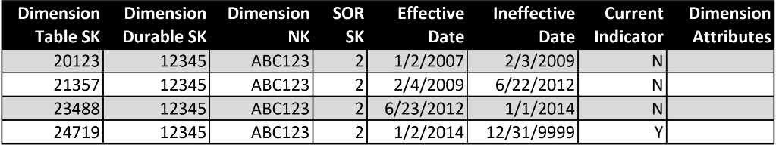
SCD type 2 schema template example
f10-16

Slide 22
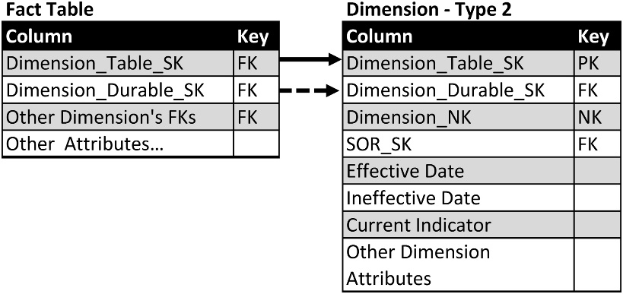
Fact table links to SCD type 2 dimension
f10-17
In the type 2 technique, fact tables linked to a dimension table include two foreign keys: Dimension_Table_SK and Dimension_Durable_SK as depicted in Figure 10.17. This enables business analysis to select the dimensional values for the following different timeframes:
To get the values at the point of time that the fact occurred “as was,” select the row based on Dimension_Table_SK.
To get the current values, select the row based on Dimension_Durable_SK and where the Currrent_Indicator = “Y” (or whatever flag was used to indicate it is the current row).
To get the value at any particular point in time, select the row based on Dimension_Table_SK with the date of interest being between the effective date and ineffective date.

Slide 23
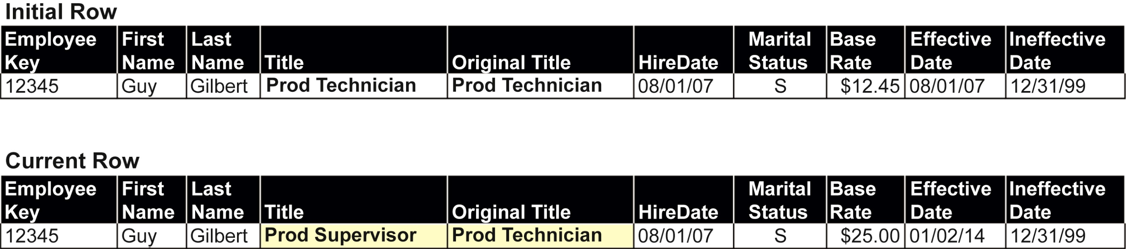
SCD type 3: Track Changes Using Separate Columns but Overwrite the Rest
The example in Figure 10.18 shows the same employee as previous examples. We want to track the employee’s current title and his original title when hired. The initial row shows the employee attributes at the time of hire. The current row has the current values of the employee attributes but, just as with type 1, we have no visibility to what attributes have changed with the exception of the attributes that were added to support type 3. In our example, we selected the title as the attribute we’re tracking, so we have both the current title, production supervisor, as well as the original title, production technician.
f10-18 Employee dimension SCD type 3
Although type 3 is not as commonly used as other SCD techniques, it is very useful in specific business conditions such as health care and financial services.

Slide 24
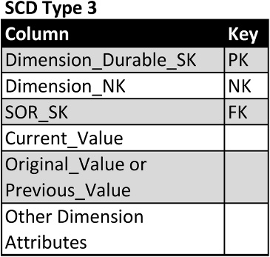
SCD type 3 template
• Dimension_Durable_SK: as with type 1, this is the surrogate key used as the primary key for this dimension. This column is referred to as the durable, supernatural, or durable supernatural key. The term durable is used because the key values that are assigned to a dimension will continue to be used regardless of any changes in the values in the SOR. The term supernatural is used to distinguish the key as independent from the SOR natural key.
• Dimension_NK: as with SCD type 1, this is the natural key from the SOR. This column has the data type of the SOR if there is only one SOR or if all the SORs have the same data type. If there are multiple source systems with different data types, then use a data type such as a character string that can store all the natural keys’ values.
• SOR_SK: as with SCD type 1, if the dimension has multiple SORs, such as a product dimension obtaining product lists from multiple source systems, then the SOR_SK is the foreign key linking to the SOR dimension depicted in Figure 10.11.
• Current_Value: The current values of the attribute using the type 3 technique.
• Original_Value or Previous_Value: Either the original or previous value of the attribute using the type 3 technique.
• Other Dimension Attributes: as with SCD type 1, there are one or more columns providing the values of all the attributes that the business needs to track.
With the type 3 technique, fact tables linked to a dimension table use the foreign key. For example see Dimension_Durable_SK in Figure 10.20.
f10-19

Slide 25
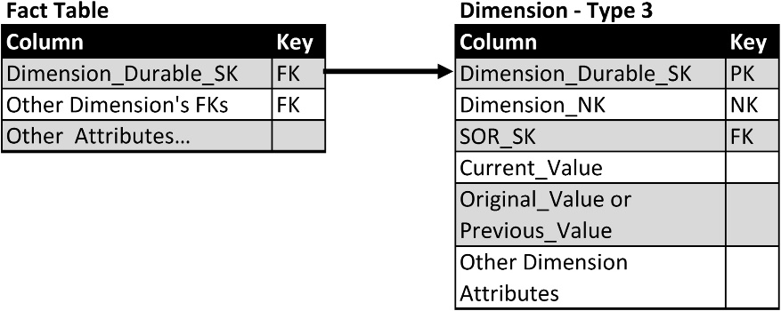
Fact table links to SCD type 3 dimension
f10-20

Slide 26
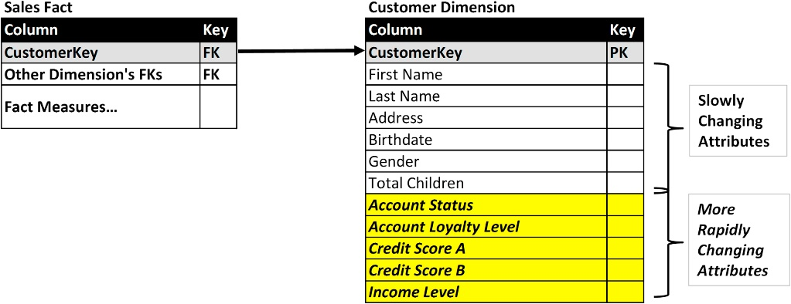
Slowly and rapidly changing attributes
f10-21
Although we characterize dimensional attributes as changing slowly over time, there are instances when they change more frequently. These attributes are referred to as rapidly- or volatile changing dimensions.
When rapidly changing dimensions are encountered and dimensional tables are relatively large in respect to the total number of rows, then these attributes may adversely affect both loading data and BI query performance.
The example in Figure 10.21 shows a customer dimension that has both slowly and rapidly changing attributes.

Slide 27
Customer dimension with both slowly and rapidly changing attributes
With the SCD type 4 (add mini-dimension) technique, the approach is to divide the slowly and rapidly changing attributes into two groups: The first group contains the SCD and is regarded as the primary or base dimension. The second group, referred to as a profile, contains the more rapidly changing dimensions that are put into a mini- dimension.
As with many dimensional modeling techniques, there are mini-dimension variations used to address specific business processes or analytical scenarios. These approaches are:
split,
multiple, and
banded-value.

Slide 28
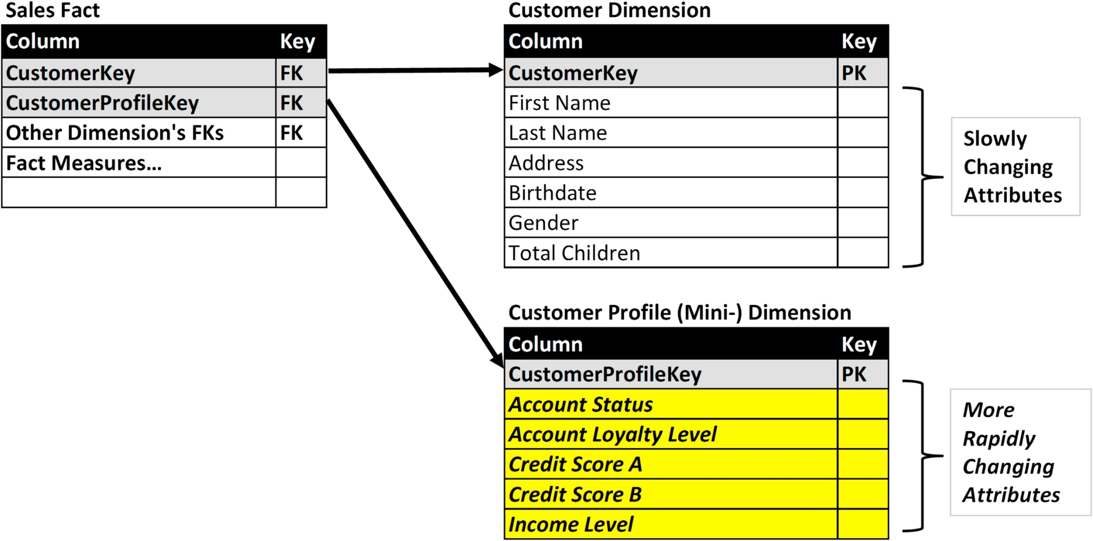
Customer dimension example split into primary and mini-dimensions
f10-22
Split approach—single mini-dimension. The most common approach is to simply put the dimensions into primary and mini-dimension tables. Any fact tables that link to the split dimension would have foreign keys linked to these two tables.
Figure 10.22 depicts the customer dimension shown in Figure 10.21 split into two tables: Customer dimension and Customer profile dimension (mini-dimension.) We have retained the original foreign key, CustomerKey, in the Sales Fact, but now have the primary key from the mini-dimension, CustomerProfileKey, as an additional foreign key.

Slide 29
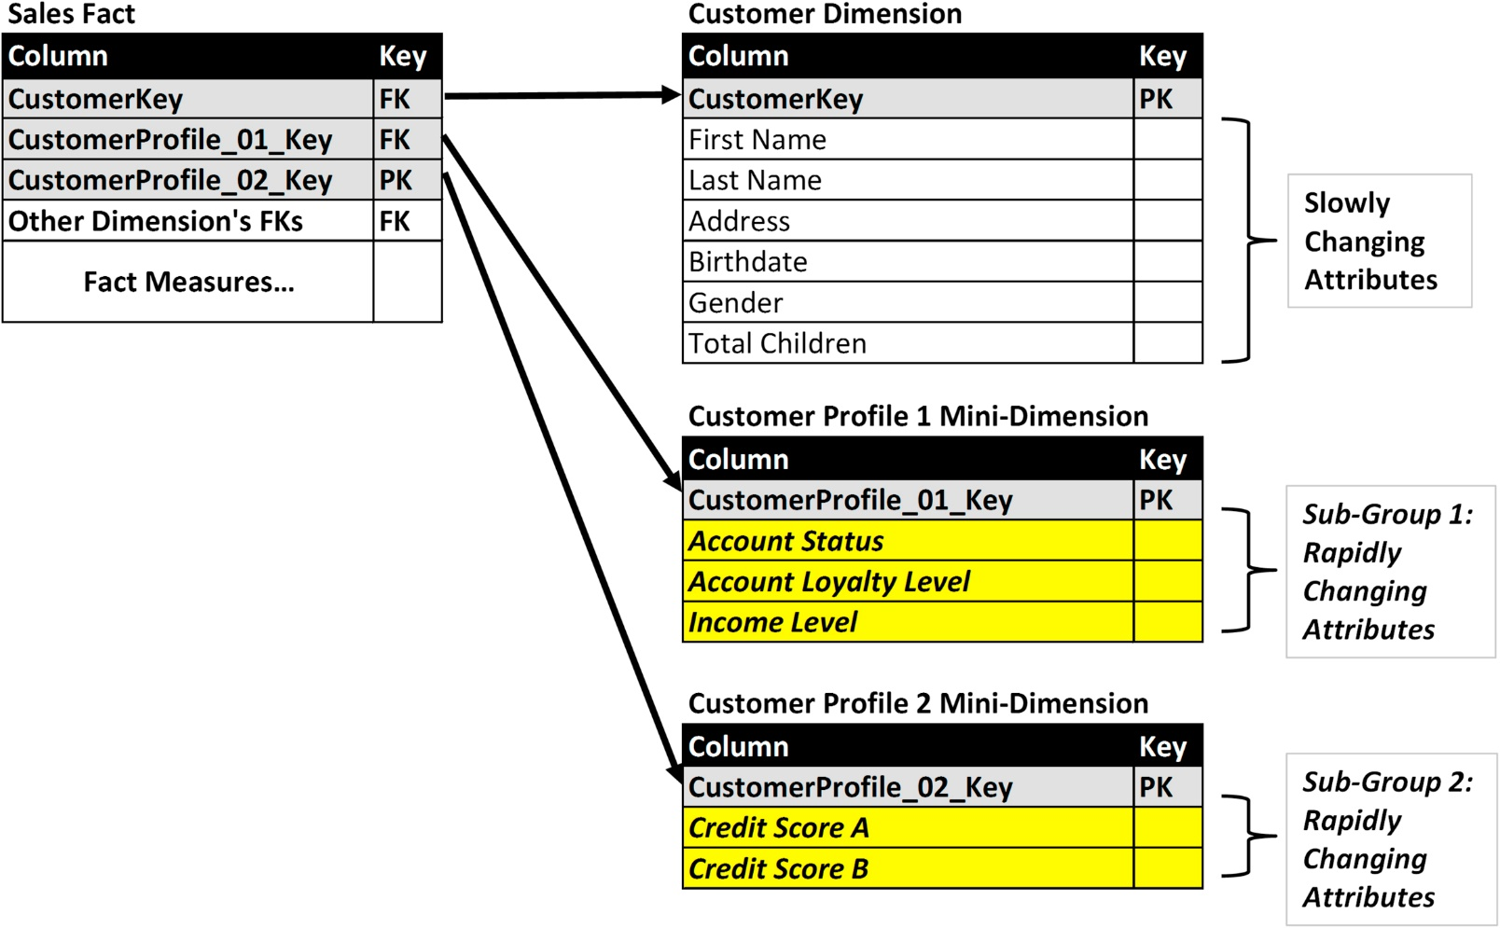
Customer dimension example with multiple mini-dimensions
f10-23
Multiple approach—multiple mini-dimensions. There are circumstances in which there are subgroups of rapidly changing attributes that behave in a similar manner. The subgroups may be updated at similar frequencies and times, or by common business processes. Under these circumstances, it is often beneficial from a processing perspective to split each subgroup into its own mini-dimension as portrayed in Figure 10.23. The relevant fact tables have foreign keys to the primary dimension table and all the mini-dimensions.

Slide 30
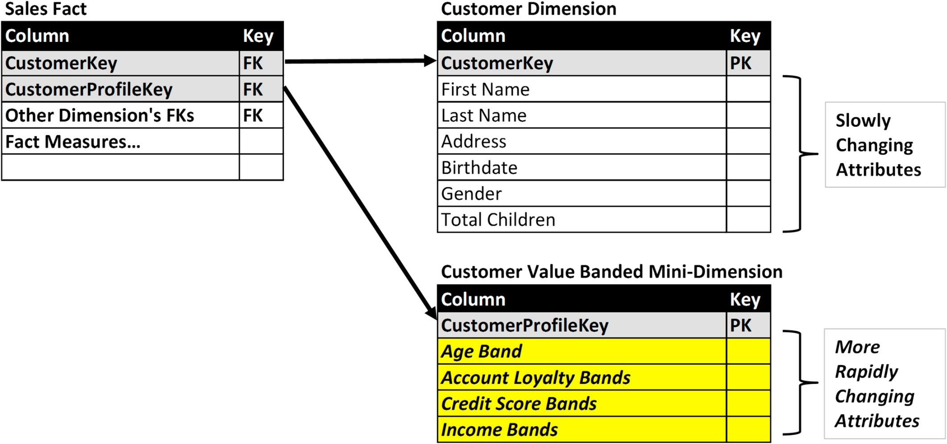
Customer dimension example with value-banded mini-dimensions
f10-24
Banded-value approach. This technique with mini-dimensions is useful when the rapidly changing attributes in the customer dimension are numeric values such as credit scores, account loyalty levels and income levels. Under these conditions, you define segmentation bands that group a range of values together. This reduces the amount and frequency of changes in the segmentation bands. Figure 10.24 depicts our customer mini-dimension example that has been altered to store banded values, such as age, account loyalty, credit score, and income rather than the underlying numeric values. This is a way to avoid frequent changes because, for example, you have an income range instead of specific income numbers. You only have to update the record if the person goes above or below the threshold for that band. The primary risk with this approach is that once you lose the detail you are forced to stay with this segmentation even if business conditions or analytical needs change. There is a discussion of value-band dimensions later in this chapter.

Slide 31
Mini-Dimensions Need Outrigger
The classic design for SCD type 4 with a mini-dimension has the fact table storing the foreign keys to the primary and mini-dimensions, but no relationship between the dimensions themselves.
With the classic design, your only way to relate the primary and mini-dimensions is through a fact table as an intermediary, which has the following drawbacks:
Slow query performance both in updating dimensions and BI queries.
Redundant combinations are returned in join queries based on how many times the dimension tables are referenced in the fact table.
Gaps will exist where a primary dimension will not be able to connect with its associated mini-dimension because neither is referenced in a fact table.

Slide 32
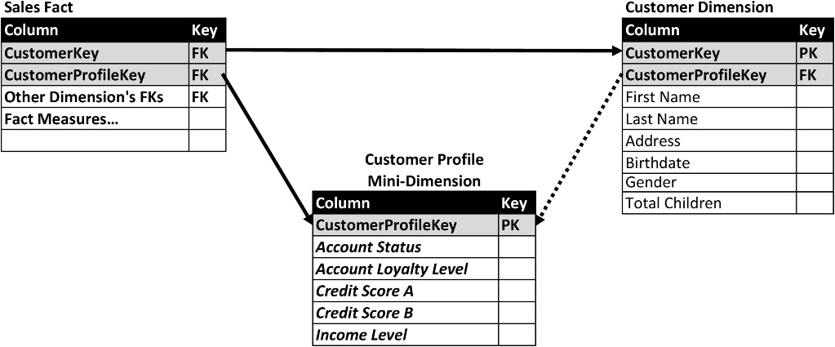
Mini-dimension as outrigger
The best practice is to place a foreign key to the mini-dimension in the primary dimension as depicted in Figure 10.25 where CustomerProfileKey links the customer dimension to the customer profile mini-dimension.
f10-25

Slide 33
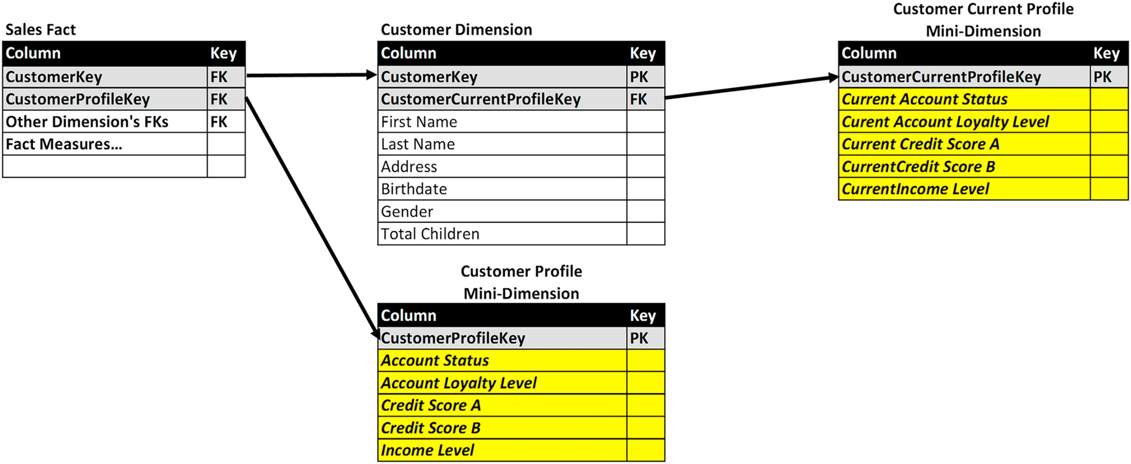
Customer example type 5 with second mini-dimension
SCD type 5: Combine types 4+1
The SCD type 5 technique builds upon the type 4 technique by splitting the dimension into a primary dimension with the slowly changing attributes and a mini-dimension with the rapidly changing attributes.
It then grafts the type 1 technique of storing a current copy of the mini-dimension attributes.
f10-26
There are several approaches to implementing type 5:
• Create a separate mini-dimension that contains the current values of the rapidly changing attributes as depicted in Figure 10.26. The primary dimension, Customer Dimension, contains the foreign key, CustomerCurrentProfileKey, to the second mini dimension, Customer Current Profile Mini-Dimension.
• The second mini-dimension, Customer Current Profile Mini-Dimension in our example, is actually a view created from the first mini-dimension, Customer Profile Mini-Dimension using a Current_Indicator attribute that is present in type 2 dimensions (which both the primary and first mini-dimensions are.)

Slide 34
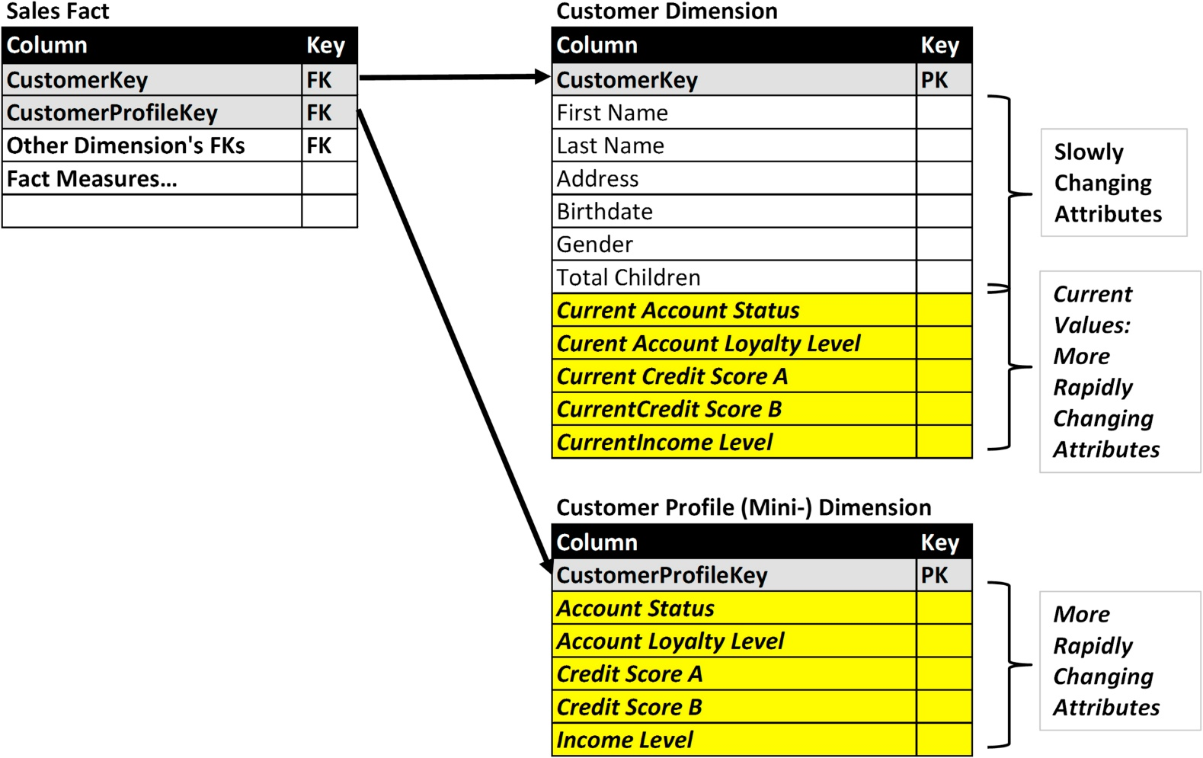
Customer dimension example with hybrid mini-dimensions
f10-27
• In the third approach, place the current values of each of the rapidly changing attributes in the primary dimension table. Figure 10.27 depicts the customer dimension with each attribute in the mini-dimension (account status, account loyalty level, etc.) having corresponding attributes in the primary dimension with the current values (current account status, current account loyalty level, etc.).

Slide 35
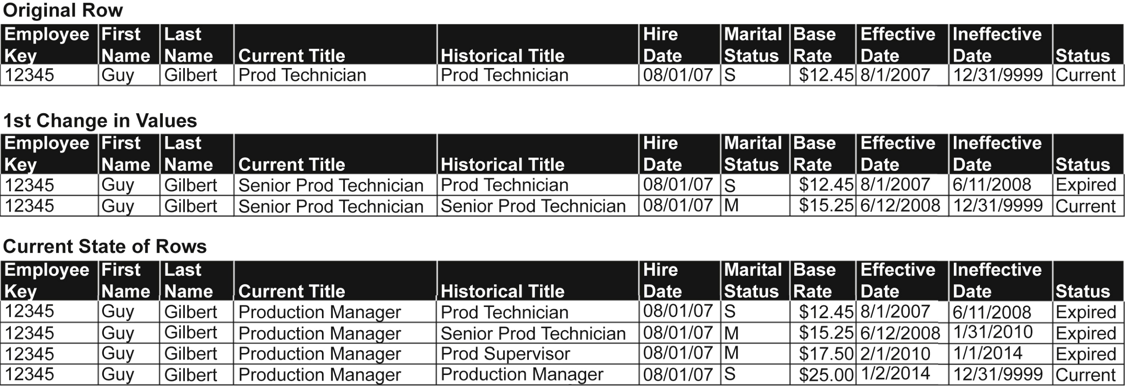
Employee example SCD type 6 (combine types 1+2+3 =6)
f10-28
Figure 10.28 depicts an employee dimension using the type 6 technique. The example shows three different states of the dimension’s rows for a specific employee: original row when the employee is hired, the first time the employee’s attributes are changed—he or she got married, received a promotion and salary increase, and the current state of his or her employee records listing all the changes in title, marital status and salary. As with the type 2 technique, the effective and ineffective dates of each row are recorded along with a current status indicator. The Historical Title column lists his or her title during the effective time period, whereas the Current Title is always updated to reflect the current title.

Slide 36
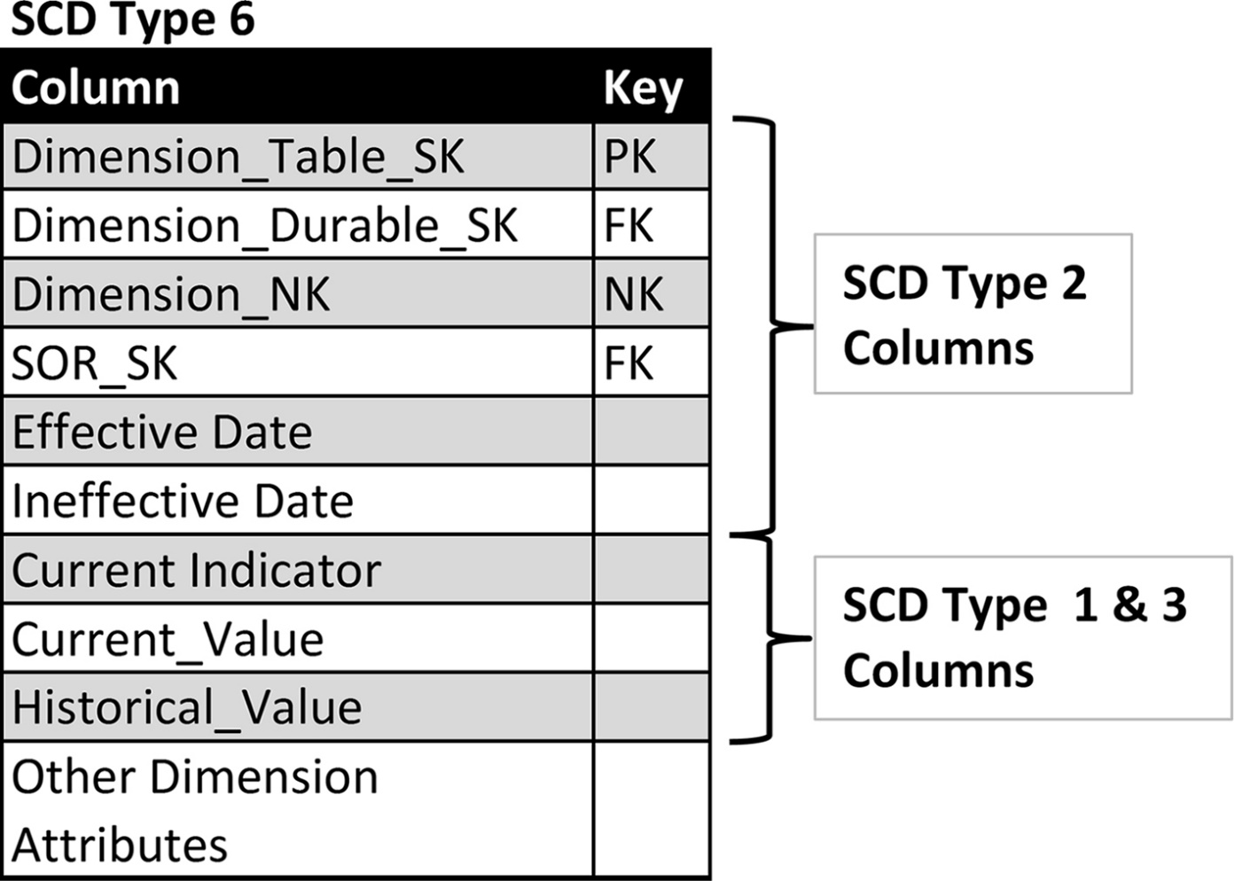
SCD type 6 schema
f10-29
The blended SCD types 3 and 1 techniques are provided by the following columns:
• Current_Value: The current value of the attribute being tracked. This value is applied to this column in all rows associated with the durable key.
• Historical_Value: The value of the attribute being tracked at the point in time that the row was initially created. This value does not change once it has been input into its row.

Slide 37
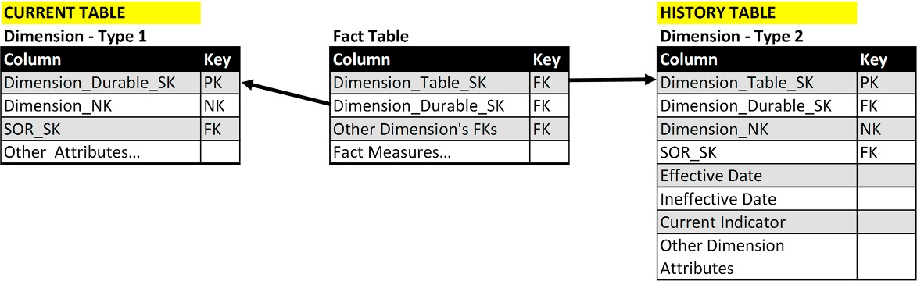
SCD type 7 schema (Type 7:use both types 1+2)
Figure 10.30 depicts a schema supporting the SCD type 7 technique. There are three types of tables involved: fact, current (type 1), and history (type 2).
f10-30

Slide 38
SCD type 7 schema (Type 7:use both types 1+2)
SCD type 7 technique creates both type 1 and type 2 versions of a dimension.
From a data perspective, with this technique you accurately track all the historical changes to dimensional attributes that the business requires.
From a business analysis perspective, you have the option to either expose the historical values in the type 2 dimension for both “as was” and “as is” analysis or provide current values from the type 1 dimension for “as is” analysis.
The benefit of offering both is that when only “as is” is needed query performance and business productivity are greatly increased. Because a considerable portion of business analysis will be “as is,” these benefits will occur often.
SCD type 7 technique is recommended as the best pragmatic approach to capturing historical values and then matching the appropriate schema for the business analysis that is going to be performed. You only need to provide current values (type 1). It greatly simplifies querying, lessens the chance for errors, and improves understanding. As an aside, this technique is used by some of the Master Data Management vendors. The SCD type 7 technique goes by many other names:
SCD type 4—this was its first name until the numbers were shuffled around
SCD hybrid approach
Current and history table approach

Slide 39
Causal dimensions
Facts have obvious attributes such as product, customer, geography, and time. This is the “who, what, where” of the fact. But facts also have a “why” component. This is the causal dimension.
The causal dimension tells you why a customer bought or returned a product. Examples of causal relationships include promotions, campaigns, and the reason for sales and returns.
This can be very important information, but often these relationships are overlooked in the initial design of a dimensional model.
They tend to be overlooked when promotion or campaign data is being stored somewhere outside of the enterprise application that is the primary source system feeding the dimensional model, such as in a campaign tool or a separate database. This, in effect, hides the attributes and dimensions from the source system you’re actually pulling data from.
Likewise, reason codes—reasons why people buy, exchange or return products—typically aren’t in the initial source system either, causing them to be overlooked. These reason codes can be essential for sales and marketing analytics on customers behavior, so bringing this data into view is very important.

Slide 40
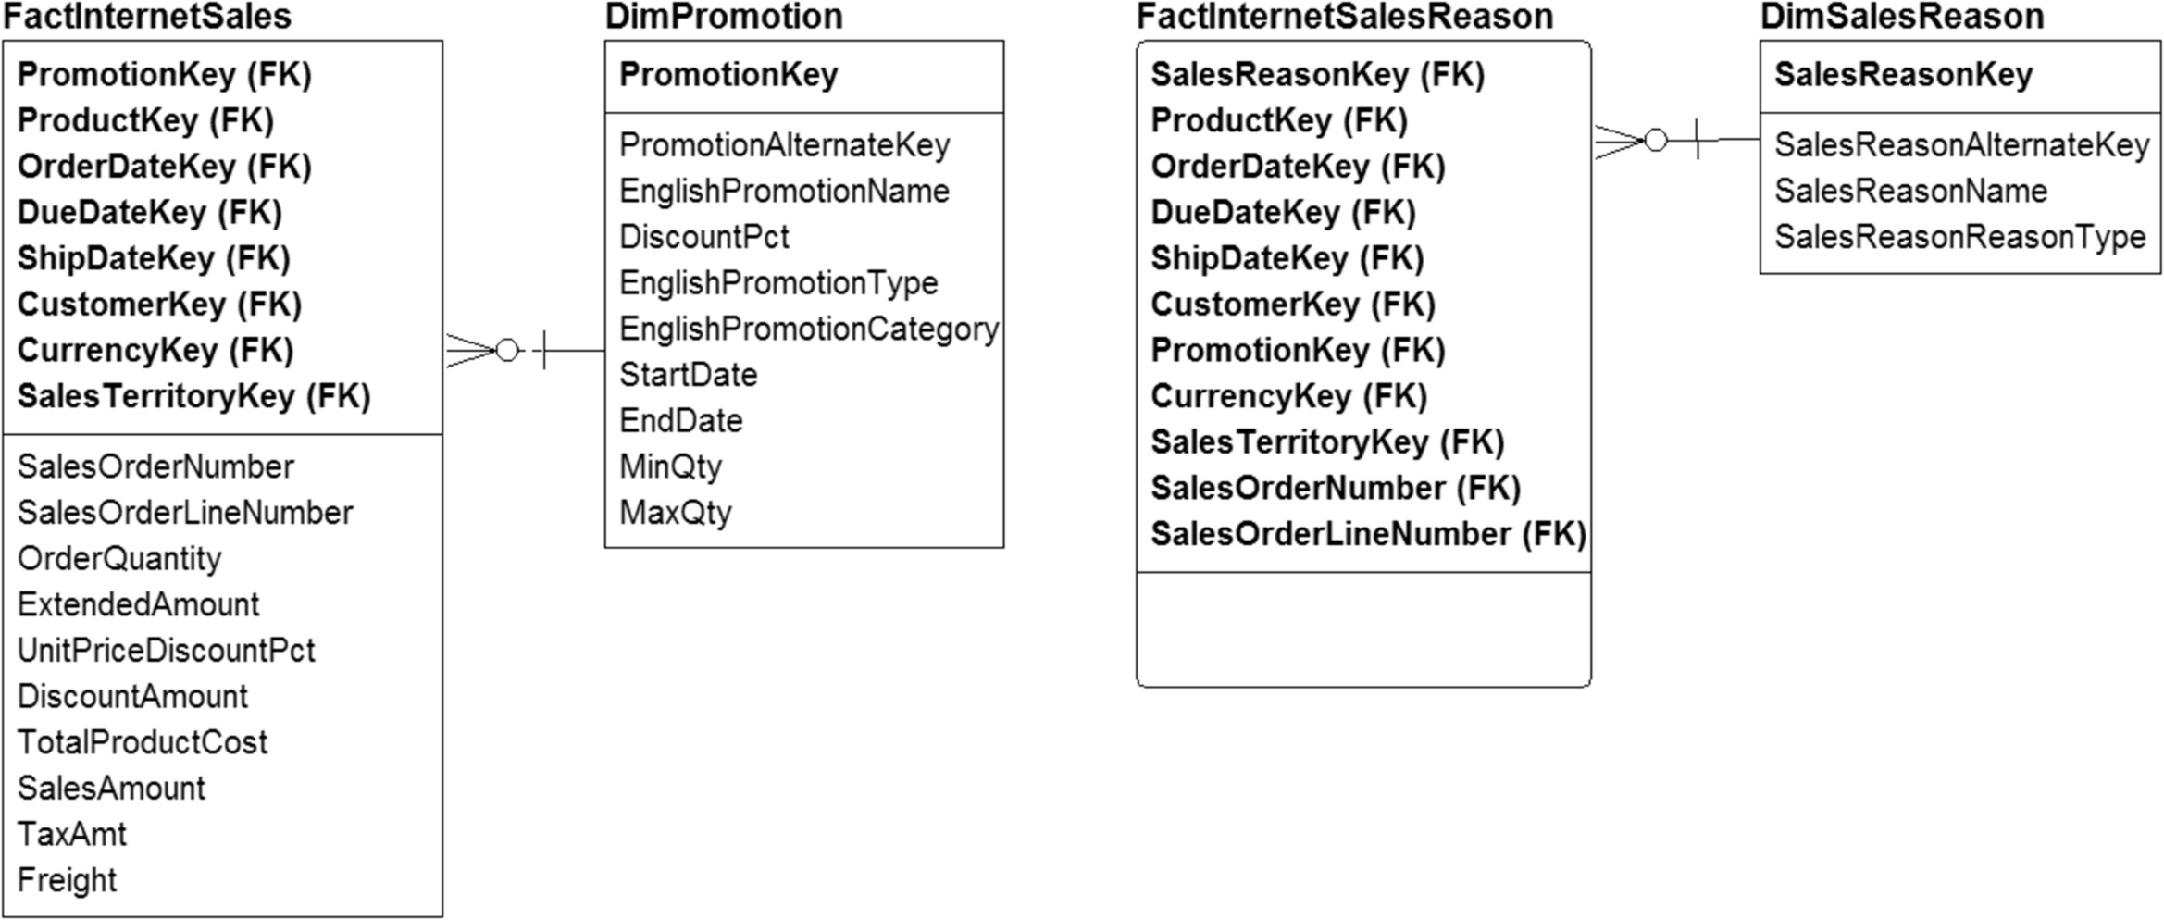
Causal dimension examples
f10-31
Figure 10.31 shows two casual dimensions: DimPromotion and DimSalesReason.
On the left side, the fact table FactInternetSales with the foreign key PromotionKey, links to the casual dimension DimPromotion, which has attributes such as promotion name, item discount amount, promotion type, category, start and end dates, and quantities for that promotion. With this promotion dimension, the business can track the effectiveness of the promotion, view trends for different types of promotions, and undertake related analytics.
The fact table FactSalesReason has the foreign key SalesReasonKey that links to the casual dimension DimSalesReason, which has the attributes for why somebody bought or returned a product. These reasons might be captured by a call center worker, by a salesperson, or online in a survey. The information provided by the causal dimensions is invaluable to the marketing and sales analytics.

Slide 41
Multivalued Dimensions
When you start to encounter more complicated data situations that require advanced data modeling techniques, you may need to use a multivalued dimension situation.
These kinds of situations arise when a fact measurement is associated with multiple values in a dimensional table. This is opposed to the more typical scenario, in which a fact measurement is associated with one value in a dimension, allowing a normal fact and dimensional star schema.
Health care is a common real-world example of multivalued dimensions. A patient arrives at the emergency room after a vertigo episode caused him to fall and break his arm. He will have at least two diagnoses— vertigo and broken arm—and will require several types of treatments for the vertigo and setting the broken bone. The hospital has diagnostic codes for each ailment and procedure codes for each treatment. The hospital must track all of the codes for this patient’s visit and any subsequent visits.
Insurance and financial accounts provide another example. It is common for financial accounts and certain types of insurance policies to be associated with two account owners or policy holders.
There are three typical approaches to handling these complicated data situations:
Pick one value, ignore others: the problem, of course, is that if you pick one specific value and ignore the others, you lose all the other details. If the details are essential such as in the healthcare example, the details are lost.
Extend the attributes: extend the dimension attributes to include a fixed number of multivalue dimensions. this creates a list within the dimensional row. For example, the hospital could assume no one will have more than 10 diagnoses, so you would put in 10 columns, one for each code (or make it 20 to add a buffer). It’s a quick way to solve the problem when you can assume that there is an upper bound to the number of times that an attribute can occur. But it is limited by the context of the upper bound, and, more importantly, that you’re imposing a repeating group into your dimensional row.
Create a bridge table: (next slide).

Slide 42
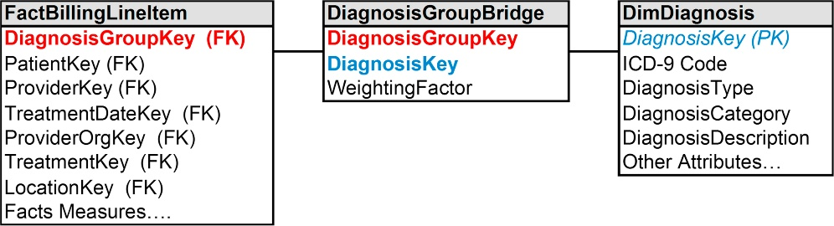
Multivalued Dimensions: Bridge table approach
f10-32
The bridge table needs to support the many-to-many relationships between a fact table and associated dimensions. The example in Figure 10.32 depicts:
• Fact table: FactBillingLineItem with information about the patient, about the provider (doctor), treatment date, what organization the doctor is from, other key information such as treatment and location. It contains the foreign key DiagnosisGroupKey that links to the bridge table.
• Bridge table: DiagnosisGroupBridge with the DiagnosisGroupKey that is used to group the set of diagnoses that a patient encountered in a visit to a provider (i.e., a row in the fact table), the foreign key DiagnosisKey linking to the dimension table, and a weighting factor (discussed in the following section).
• Dimension table: DimDiagnosis with a primary key of DiagnosisKey and several types of medical terms or categorizations that are applicable to that diagnosis.

Slide 43
Multivalued Dimensions: Bridge table approach (Cont.)
The weighting factor:
A bridge table has a weighting factor if all the members of the DiagnosisGroupKey are not considered equal and are determined by a predefined weighting.
Typically the weighting factor adds up to one. In the example, this relates to one visit to the doctor.
There are two types of queries with a bridge table:
Queries with a weighting factor to allocate the values. For example, based on a health care insurers’ contract, a health care provider, such as the doctor, will use the weighting factors when “scoring” (i.e., aggregating attributes from the diagnosis dimension).
Queries without a weighting factor to allocate the values. In this scenario, the health care provider treats each diagnosis equally and aggregates the diagnosis dimension’s attributes without applying any weighting factor. Suppose you want to know how many times, for example, swine flu was diagnosed. That would be one occurrence in multiple group keys. So you ignore the weighting factor; in this case, you’re just trying to get the total number of diagnosis keys.
Using the bridge allows you to perform analysis of facts and dimensions with a many-to-many relationship. It also enables the ability to treat the relationships equally or, as so often happens because the relationships are not all equal, to use a weighting factor based on business rules.

Slide 44
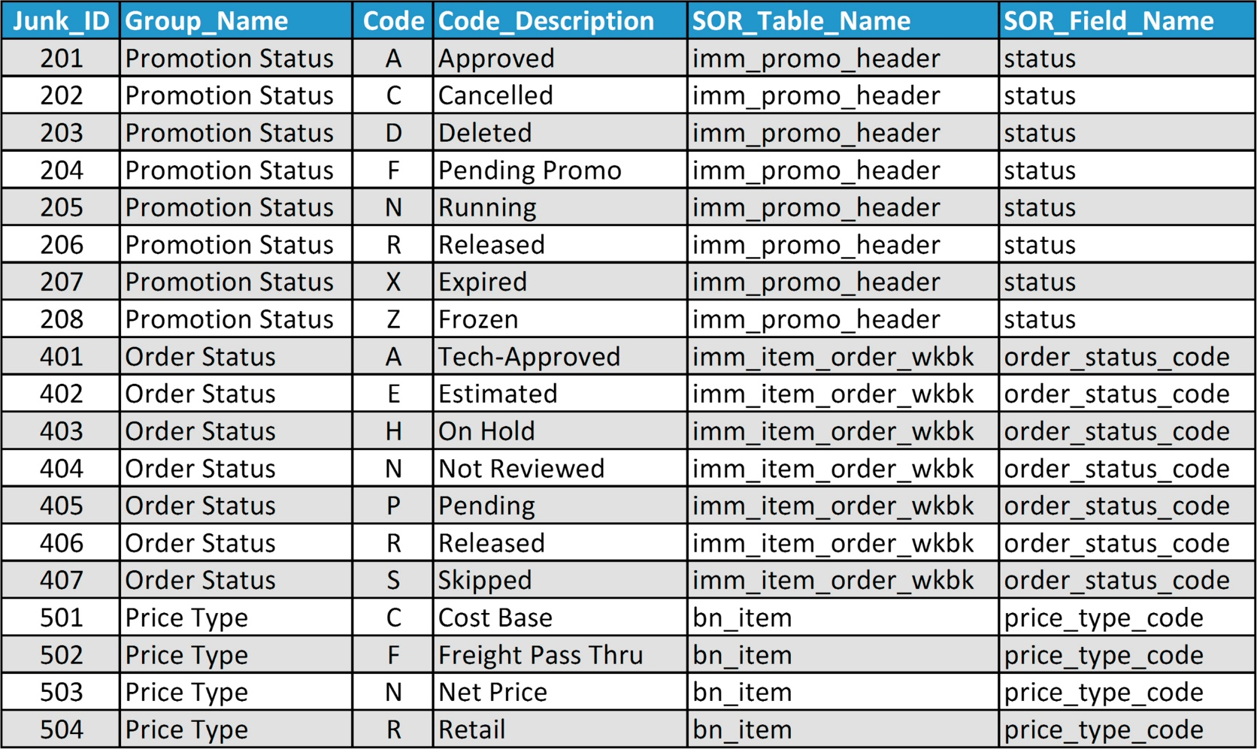
Junk dimension example
In the example in Figure 10.33, code fields and their descriptions are grouped together based on common usage and input into a junk dimension. The columns in this example are:
Things that you know you’ll need some day, but you’re not sure where else to put them.
Junk dimensions are a way to handle the multitude of low-cardinality transactions, system codes, flags, identifiers, and text attributes by putting them into one table so you can better manage them.
These are also called “cross-reference dimensions”. The term junk dimension, however, is well-recognized in the industry.
The primary function of this junk table is to enable filtering reporting. It prevents these attributes from being embedded in the report code, and it enables a much better documentation of the system.
The code fields presented in Figure 10.33 are often used for filtering and grouping data in reporting. A BI application such as a dashboard or interactive report might provide pick lists or pull-down menus using the groupings and codes as the options presented.
Creating a junk dimension replaces hard-coded options in applications, makes it easier to maintain and change these codes, and increases the ability to reuse and share because these codes are in tables rather than embedded in code or personal spreadsheets.
f10-33
• Junk_ID—surrogate key • Group_Name—a set of common code fields • Code—list of code fields • Code_Descriptions—textual description displayed for the codes • SOR_Table_Name—table from source system from which these codes are obtained
• SOR_Field_Name—field in table from which these codes are obtained

Slide 45
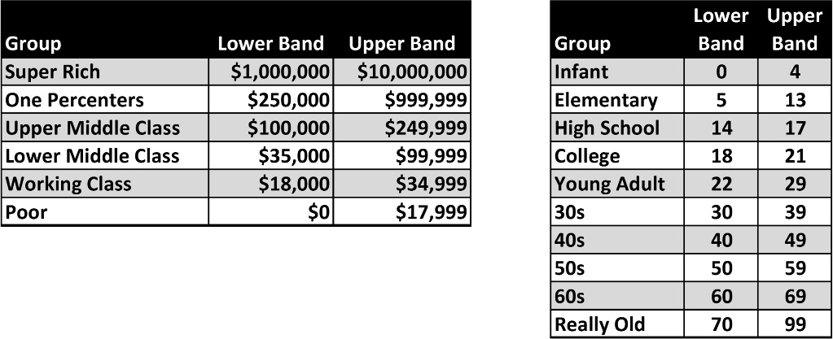
Value band reporting
Fact measures, especially numbers, is not so easy or efficient. Often the range of numbers is hard-coded into a report, making it impossible to make changes to that band or even document what that band is. So the best practice is to create value band groupings for particular fact measures.
f10-34
The two examples in Figure 10.34 are for income and age. The income column includes bands from the US Census Bureau: super rich, rich, upper middle class, lower middle class, working class, and poor. (That is the Census Bureau’s wording) The age column has bands for age groups: infant, elementary, high school, college, young adult, 30s, 40s, 60s, and really old. Both have a lower and upper band.
The examples show that two different groups or kinds of analysis might need to group income levels differently. They might have more groups of income levels. The same applies to the age groupings. If you’re selling toys, you might have a fine-grained age band for younger people and may not care about anyone over the age of 12.
It’s best practice to put these bands into tables, rather than hard coding them into reports.

Slide 46
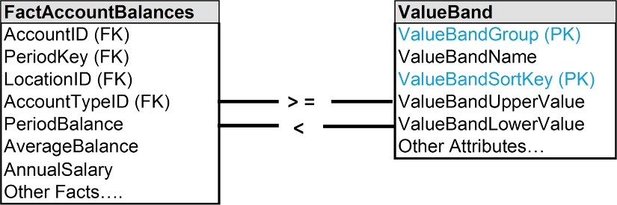
Value band reporting approaches
Rather than hard-code value bands in reports, you should use a value band table for analysis. Figure 10.35 depicts an example where a fact table, Fact_Account_Balances, uses the value band dimension, Value_Band_Dimension, to group accounts by ranges of account balances. The value band dimension contains the following:
• ValueBandGroup: Primary key
• ValueBandName: Name used to describe the band, such as super rich and poor in the previous example. This column would be used for filtering, sorting, and grouping accounts in reports.
• ValueBandSortKey: Often the ValueBandName does not sort in the order that business people prefer, so this numeric column would be used to obtain the preferred order.
• ValueBandUpperValue: The upper bound of the range in this value band.
• ValueBandLowerValue: The lower bound of the range in this value band.
f10-35
When assigning accounts to value bands, the account’s PeriodBalance, for example, is compared with the value band upper and lower values.
This example allows numerous value bands for age and income depending on who wants to look at the numbers. It lets you change the bands without having to change the fact table.
It’s also possible to take a hybrid approach, where you follow the first approach, which is to create the value band table and put the foreign key in the fact table, but then keep the original fact measure in the balance table

Slide 47
Alternate dimensions
The classic assumption is that facts are connected to a set of conformed dimensions, meaning that all business analysis uses the same definition and hierarchy of a specific dimension.
That implies that there is only one way to group customers or products, for example.
But this attempt to create conformity inhibits the ability to create customized views of dimensions to match the analytical requirements of business functions and processes.
Finance, marketing, sales, and manufacturing may have legitimate business needs to group customers and products differently.
When one standard dimension is available for business analysis, then the burden is shifted to business people to create the alternative views of the dimensions. This is typically done by extracting data to spreadsheets to enable analysis using alternative versions of dimensions that were created manually by business people.
Not only is this a productivity drain, but there is no documentation, sharing is haphazard, and the potential for inconsistency is high.
Dimensional models need to accommodate alternative views of dimensions to support business needs, improve productivity, and provide consistency. There are two basic approaches:
Hot swappable dimensions (also called profile tables)
Custom dimension groups

Slide 48
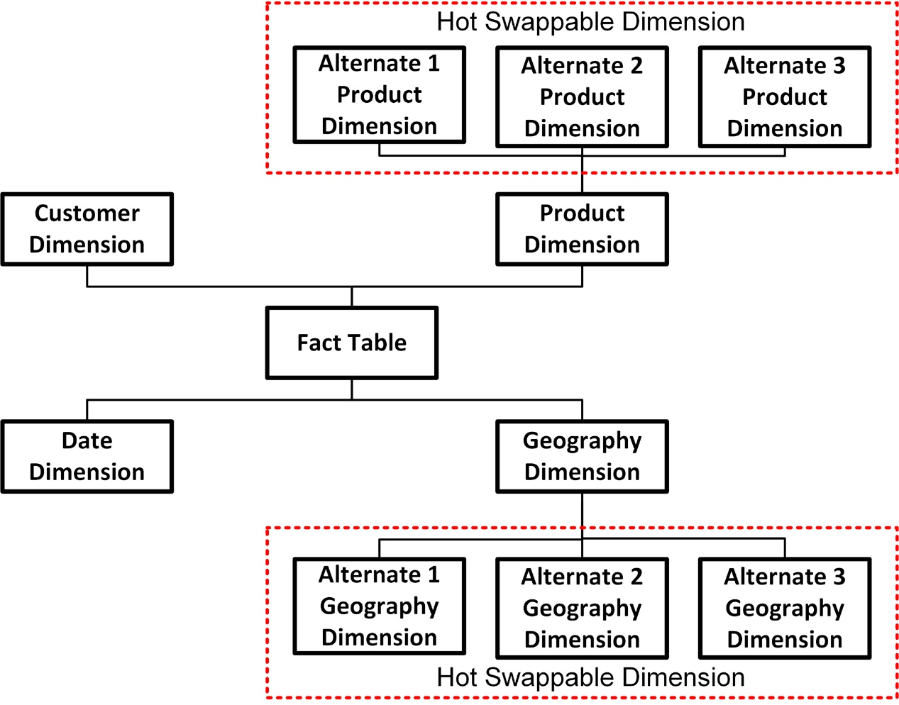
Hot swappable dimension example
Hot swappable dimensions are implemented by connecting a fact table with alternate versions of a dimension, then using one alternative for analysis at query time.
The alternative is either selected by the business person explicitly or automatically by the BI application based on specific business rules.
They got their name because someone thought it was analogous to hot swappable hardware components that are switched in real time.
f10-36

Slide 49
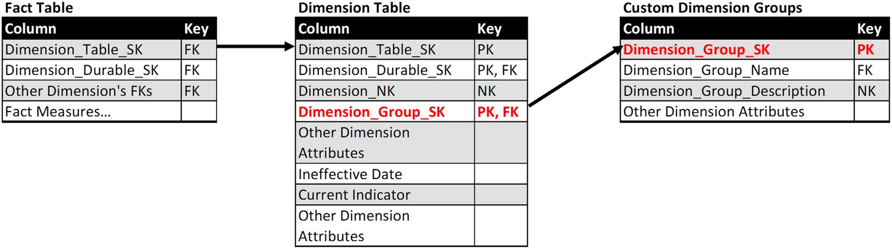
Custom dimension groups
The second approach to creating alternative dimensions is to enhance the dimension’s schema to accommodate different dimensional groups.
As depicted in Figure 10.37, an additional dimension is created, Custom_Dimension_Groups that has a row for each alternate grouping with descriptive attributes. The new dimension could be used as a filter to select alternates during query time or to create views that would be made available to specific groups of business people. The foreign key Dimension_Group_SK is added to the dimension table.
f10-37
The primary key for the dimension table is a combination of Dimension_Table_SK, Dimension_Durable_SK, and Dimension_Group_SK.
Fact tables are not modified, however, and continue to be linked to the dimension table using the Dimension_Table_SK as the foreign key.

Slide 50
Too Few or Too Many Dimensions
When you complete your first iteration of a dimensional model, you might find that you have too few or too many dimensions. It is common to have 6–18 dimensions to model a business process. Although there will be common or conformed dimensions across business processes, it is likely that as the number of processes modeled grows, so too will the number of dimensions.
If you have too few, consider if any of these are missing:
Outriggers
Role-playing dimensions
Causal dimensions
Multivalued dimensions and bridge tables
Value band tables
It’s possible to add any of these after you enter into the production phase of your dimensional model because they don’t affect the existing primary and foreign keys in your dimensional model. Keep in mind, however, that striving to develop a comprehensive a model early will improve productivity and analytical capabilities.
If you end up with far too many dimensions, such as hundreds, for example, then you need to determine if you have any of these issues:
Some of the dimensions are dependent on each other and need to be combined. If there is a one-to-one mapping they definitely need to be combined.
There are degenerate dimensions, which need to be collapsed as talked about in Chapter 9.
Many of the dimensions are really an accumulation of junk dimensions that could be put into one table to improve management and productivity.

